Slide 1
The Global NPO Coalition on FATF The ABCs of FATF: What Nonprofits Need to Know in 2017 and Beyond December 15, 2016 Speakers: Kay Guinane, Charity & Security Network Lia van Broekhoven, Human Security Collective Lara Kalwinski, Council on Foundations Haroun Atallah – Transparency International Ben Evans, Greenacre Group Vanja Skoric , European Center for Not-for-Profit Law Suzanne Keatinge, Dochas
This event organized, in part, under the project: “Standing up Against Counter-Terrorism Measures that Constrain Civic Space”. The project is supported in part by the grant from the Open Society Human Rights Initiative. The views in the paper do not necessarily represent the views of the Open Society Foundations. For more information visit: www.fatfplatform.org

Slide 2
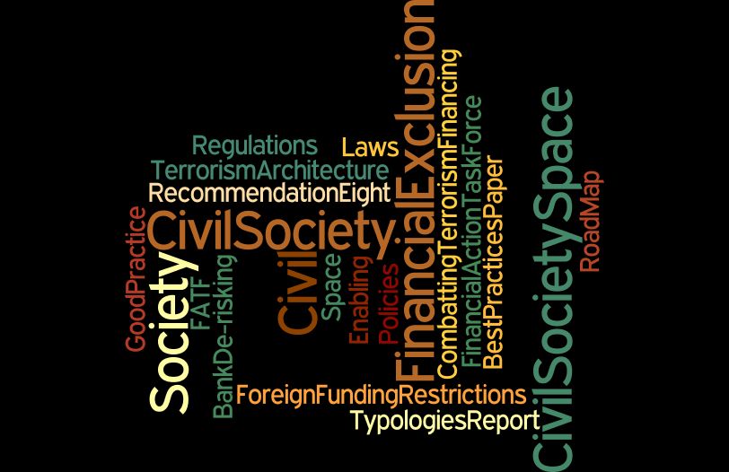
Global NPO Coalition on FATF
Lia van Broekhoven, Human Security Collective

Slide 3
What is the FATF and Why is it important
The global standard setter for anti money laundering and countering financing of terrorism standards
FATF assumes that if countries effectively implement these standards, financial systems and the broader economy are protected from the threats of money laundering and the financing of terrorism thereby strengthening financial sector integrity and contributing to safety and security
198 countries have committed to implement the standards

Slide 4
Who is the FATF
An intergovernmental body established 1989 by the G 7
Standards to counter terrorism financing included after 9/11
A task force and not a formal organization
37 Members and 9 regional bodies represented by MinFin
Works in close partnership with the UN, IMF and World Bank
A secretariat facilitates the work of the FATF and regional bodies located in Paris at OECD
Chaired by president – plenaries to discuss compliance with standards based on evaluation reports
Decision-making by consensus

Slide 5
What does the FATF do
Researches ways criminals launder money and terrorist organizations raise and access funds
Sets global standards to make it more difficult for criminals and terrorists to do this
Assesses how effective countries are at implementing the standards and mitigating risks – through rigorous peer evaluations

Slide 6
Why do civil society, nonprofits have to know about the FATF
One standard, Recommendation 8 is entirely dedicated to nonprofits
It singles out nonprofits for being vulnerable for terrorism financing abuse
Nonprofits need to be protected by government laws and regulations
Governments have intentionally and unintentionally implemented the standard in ways which led to push back of civil society
Banks being required to shore up government agendas in tackling money laundering and countering terrorism financing are de-risking nonprofits
The way Recommendation 8 has been interpreted and implemented by governments and banks important driver of the constraining of civic space and financial exclusion

Slide 7
NPO engagement with the FATF
Constructive and critical engagement since 2013
Consultations with civil society in the process of revision of Recommendation 8 and on country evaluations
Current challenge - civil society to have a permanent representation at the FATF Private Consultative Group meetings
Regional FATF bodies seek engagement with nonprofits Opportunity to strengthen engagement world-wide and potential driver for further reclaiming civic space

Slide 8
Global NPO Coalition on FATF
Lara Kalwinski, Council on Foundations

Slide 9
Rationale for change of R8 according to FATF : 1. NPO sector and the threat environment has changed 2. Reflected in two FATF papers: 2014 Typologies report and 2015 revised Best Practice paper (RBA) 3. Revised standard aims to ensure that: Implementation of R8 in line with risk-based approach and does not disrupt or discourage legitimate NPO activity

Slide 10
TAKE THE TIME TO READ: New Recommendation 8 on NPOs Countries should review the adequacy of laws and regulations that relate to non-profit organisations which the country has identified as being vulnerable to terrorist financing abuse. Countries should apply focused and proportionate measures, in line with the risk based approach, to such non-profit organisations to protect them from terrorist financing abuse,… versus old Recommendation 8 on NPOs Countries should review the adequacy of laws and regulations that relate to entities that can be abused for the financing of terrorism. Non-profit organisations are particularly vulnerable, and countries should ensure that they cannot be misused:….

Slide 11
Removal of “particularly vulnerable”: 1. Previous language singled out the NPO sector to be “particularly vulnerable” 2. led to overregulation and inappropriate restrictions on NPOs, 3. hampering their legitimate and essential work around the world. NPOs around the world have been stressing the need to stop singling out the sector

Slide 12
“Risk-based approach” – what does it mean? 1. Countries should identify which organisations fall within the FATF definition of NPO, and 2. Identify which of those are vulnerable to terrorism financing abuse (subset). 3. Countries should review adequacy of measures, laws and regulations that relate to this subset 4. Measures must be focused and proportionate in line with a risk-based approach

Slide 13
FATF R8
INTERPRETIVE NOTE SUMMARY
WHAT IS GOOD AND WHAT WE SHOULD WATCH OUT FOR
BY
HAROUN ATALLAH
GROUP DIRECTOR CORPORATE SERVICES
TRANSPARENCY INTERNATIONAL

Slide 14
STRUCTURE OF IN R 8
A INTRODUCTION
B OBJECTIVES AND GENERAL PRINCIPLES
C MEASURES
D RESOURCES FOR SUPERVISION, MONITORING AND INVESTIGATION

Slide 15
A. INTRODUCTION
This recommendation only applies to organisations within the FATF definition of NPO. NPO refers to an organisation that engages in disbursing funds for purposes such as charitable, religious, cultural, educational, social or fraternal purposes (all good work).
Recognition of the important role played by NPO’s, the efforts by the sector to manage risks, yet cases where charitable organisations or sham charitable organisations were used to facilitate terrorism were identified. Reminder that implementation by countries must respect obligations under the UN Charter and international Humanitarian law.
Reasons for vulnerability of sector identified.

Slide 16
B. OBJECTIVES AND GENERAL PRINCIPLES
The objective is to ensure NPO’s are not misused by terrorists by following these principles:
A risk based approach
Flexibility in developing a national response to terrorist financing abuse of NPO’S.
Countries adopt effective and proportionate measures commensurate with risk-based approach.
Measures should promote accountability and engender greater confidence amongst all parties including the public that funds reach their intended beneficiaries.
Countries should aim to prevent and prosecute as appropriate, terrorist financing and other forms of terrorist support.
Countries should encourage the development of academic research on, and information sharing in NPO’s to address terrorist financing related issues. This should be based on developing cooperative relationships with both the public and private sectors as well as NPO’s.

Slide 17
C. MEASURES
Countries should identify which subset of organisations fall within the FATF definition of NPO that is at risk.
An effective approach should involve all four of the following elements in order to protect NPO’s from potential terrorist financing abuse:
1. Sustained outreach concerning terrorist financing issues
2. Targeted risk-based supervision or monitoring. NPO’s could be required to licence or register
3. Effective investigation and information gathering
4 Effective mechanisms for international cooperation should include capacity to respond to international requests for information about an NPO of concern.

Slide 18
D. RESOURCES FOR SUPERVISION, MONITORING AND INVESTIGATION
Countries should provide their appropriate authorities, which are responsible for supervision, monitoring and investigation of their NPO sector, with adequate financial, human and technical resources.

Slide 19
AREAS WE SHOULD LOOK OUT FOR
How are the subset of NPO’s whose activities or characteristics may be subject to terrorist risk abuse identified?
Executive orders as a means for taking action against NPO’s should be temporary and subject to a transparent judicial process.
Laws and regulations being tailored to a subset of vulnerable NPO’s seems like an unrealistic demand.
NPO’s being required to license is not the same as register as the wording implies.
Beneficiary identity
Setting a minimum period for maintaining records of five years

Slide 20
National Risk Assessments and Risk Assessments for the NPO Sector
Ben Evans, Director, Greenacre Group

Slide 21
Two things to look our for
R1: National Risk Assessment (NRA)
Countries should identify, assess, and understand the money laundering and terrorist financing risks for the country... (FATF Methodology, 2016)
R8: Identifying NPOs at risk
…identify the features and types of NPOs which by virtue of their activities or characteristics, are likely to be at risk of terrorist financing abuse. (FATF Methodology, 2016)

Slide 22
Their Significance
Setting the TF Agenda
Justifies national policies and actions
In some cases, an opportunity to prevent excessive regulation
“It may be possible that existing measures are sufficient to address the current TF risk to the NPO sector identified in a country.”
Best Practices Paper, 7(b))

Slide 23
Problems and Risks
No data
Confidentiality
Circular categorisation
Singling out
De-risking

Slide 24
Opportunities: Risk based approach
The requirements of Recommendation 8 only apply to those NPOs which are considered at risk for terrorist financing purposes.
Regulation must be justified
Undermines old safety-first approach of over-regulation

Slide 25
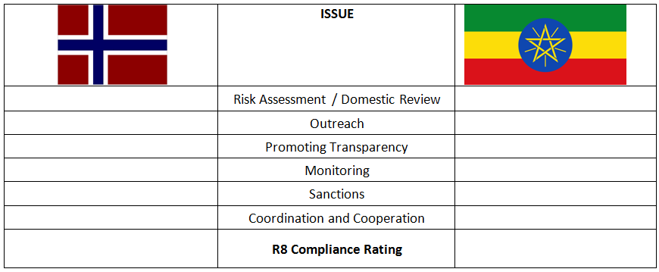
Case Study: Norway vs Ethiopia

Slide 26
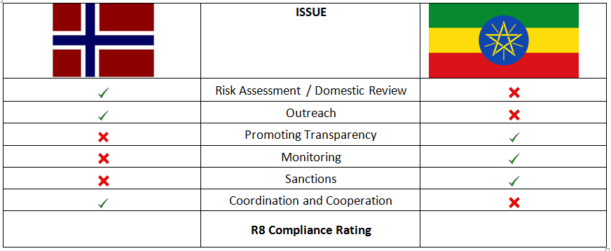
Case Study: Norway vs Ethiopia

Slide 27
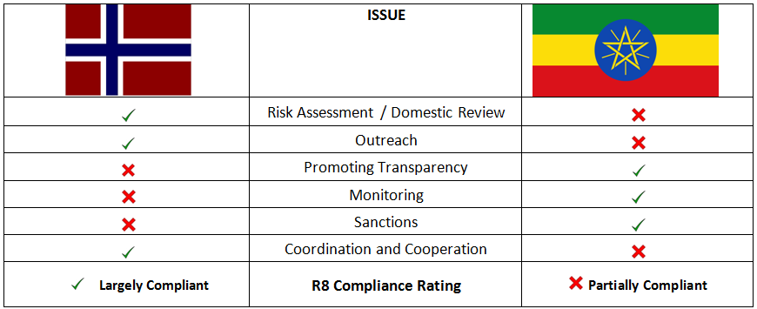
Case Study: Norway vs Ethiopia

Slide 28
Opportunities: Consultation
FATF expects authorities to consult with all stakeholders when undertaking a risk assessment;
‘Stakeholders’ should include civil society;
Evaluators will be looking for evidence of such consultation when assessing R1 and IO.1;
That R1 and IO.1 are the most important of the Recommendations and Immediate Outcomes; and furthermore...
That countries should specifically work with NPOs to develop and refine best practices to address terrorist financing risk and vulnerabilities in the NPO sector.

Slide 29
Actions
National level focus
Engage with the FIU
Challenge the old narrative

Slide 30
Actions
National level focus
Engage with the FIU
Challenge the old narrative

Slide 31
Global NPO Coalition on FATF
Vanja Skoric, European Centre for Not-for-Profit Law

Slide 32
Risk
Risk is the core of FATF standard - increasingly in the latest MERs published in 2016
If the government did not carry out risk assessment or risk-based approach, the country would likely not be compliant with R8

Slide 33
Risk
Hungary - no specific RA on NPOs; no outreach to NPOs
should conduct a formal review of the entire NPO sector in order to identify those NPOs falling within the relevant FATF definition, and identify NPOs that could potentially pose a higher FT risk. (R8 – PC)
Honduras - no RA on NPOs; no specific outreach to NPOs
- the assessment and understanding of TF risk could be improved with the inclusion of DNFBPs and NPOs into the country risk analysis. (R8 - LC)

Slide 34
Effectiveness
Effectiveness is key in relation to methodology
Evaluators ask for effective, targeted approach
Untargeted measures that restrict operating space of the entire NPO sector should be considered as non-compliant, as they are not effective
Evaluators can challenge effectiveness and use of resources when regulation imposed on entire sector
Evaluations could be an entry point to emphasise overregulation is ineffective

Slide 35
Effectiveness
Low level of implementation on effectiveness in current 4th round of FATF evaluations on R8 - only 20% of countries assessed are doing well
Uganda - no specific RA on NPOs; no outreach to NPOs
- Sanctions prescribed in the Non-Governmental Organisations Act Chap 113 as amended in 200623, of a fine or of less than one year imprisonment or both are not dissuasive, effective or proportionate enough and are not related in any way to TF. (R8-NC)

Slide 36
Effectiveness
Tunisia - no specific RA on NPOs; no outreach to NPOs
- level of effectiveness achieved for Immediate Outcome 10 is low
The Law establishes transparency measures to identify those responsible for the administration and management of associations and ensures the integrity of incoming and outgoing funds by publication of the financial statements of the associations. (R8-LC)

Slide 37
Outreach
If no outreach to the non-profit sector was conducted, if there was no discussion about terrorism financing and risks with NPOs, it is difficult for that country to score well on R8
MERs could also cite whether NPOs showed awareness of their sectorial vulnerabilities to FT threats (Belgium, Serbia)

Slide 38
Outreach
Serbia – no specific RA on NPOs; no outreach to NPOs
A formal review of the NPO sector should urgently be undertaken with regard to its activities, size and vulnerabilities to FT and adequate awareness-raising programmes should be carried out. (R8 - PC)
Switzerland –no specific RA on NPOs; no outreach to NPOs
- authorities have not conducted any outreach or training activities in the sector on TF risks. Some self-regulatory organisations are working hard at supervision, outreach and training in the NPO sector, particularly through certification and the spread of best practices. However, these are optional initiatives. (R8 - PC)

Slide 39
Entry points and recommendations
Assessed Country Trainings - encourage countries to use the opportunity of trainings offered by FATF/FSRBs, to prepare for evaluation process/include R8
Identifying sub-sector of NPOs at risk - develop clearer guidance for governments how to identify, and for evaluators on the effectiveness review

Slide 40
Entry points and recommendations
Global Network Coordination Group (incl. FATF and FSRBs Secretariats, WB, IMF) - share evaluation-related material developed by FATF Secretariat among members to help facilitate and simplify the process
These might include templates and guidance on NPO engagement

Slide 41
Entry points and recommendations
Guidance to evaluators on engaging with NPO sector - standardized approach that can consider good practices:
- Provide information on how NPOs can be
informed in advance to prepare for evaluation
- Provide guidance on how NPOs can submit input to evaluators prior to the visit (i.e. FATF templates for inputs made available to NPOs)

Slide 42
Global NPO Coalition on FATF
Suzanne Keatinge, Dochas

Slide 43
Questions asked of Irish NGOs as part of FATF assessment
15 November 2016
How are charities vulnerable to terrorist financing?
Have charities taken steps to address vulnerabilities?
What information/guidance is given by the government/charities regulatory authority (CRA) to NGOs re terrorist financing
National Risk Assessment – were you involved in the process?
What were charities experience of the registration process for CRA?
Have there been any inspections of registered charities?
To the extent that it has been possible, what has been the government/regulators approach on terrorist financing?
What work still needs to be done? How do you think you could get more support from the authorities?
To what extent is Ireland applying focussed proportionate measures to NPOs?
What kind of sanctions could governments/regulator apply?
Do you agree with the National Risk Assessment
Are there any ways the government/CRA could improve re Terrorist financing

